Slide 1
Activity Inference from Audio Signal Using Knowledge Base
Menglu Li, 12 June 2013

Slide 2
Roadmap
Introduction
System Implementation
Evaluation

Slide 3
Roadmap
Introduction
Why Environmental Sound Recognition (ESR)
Terminology & Typical Workflow
Our Work
System Implementation
Evaluation

Slide 4

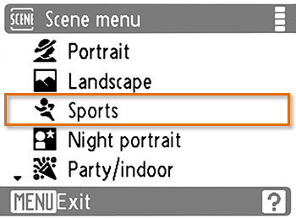
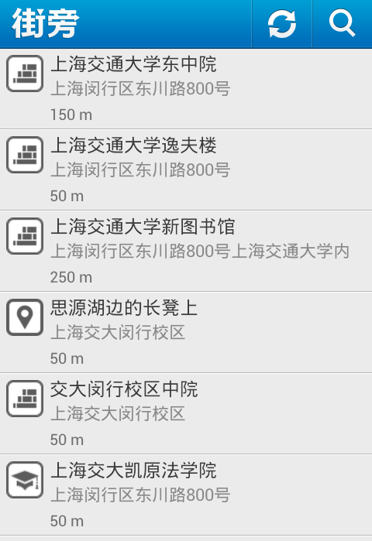
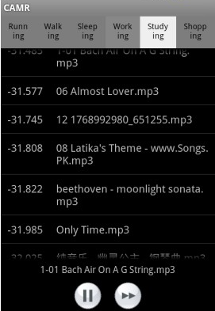
Why ESR
Why activity inference?
Why from audio signal?
a rich set of information
insusceptible to the sensor’s position and orientation

Slide 5
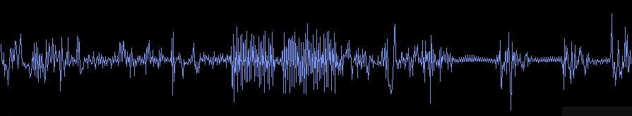
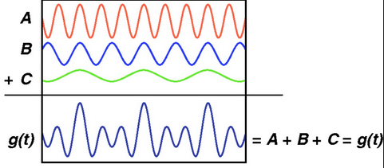
Terminology
Context vs. Event
café vs. cups hit dishes, spoon stirring, whisper
Temporal feature
Short-Time Energy, Zero-Crossing Rate (ZCR)
Cepstral feature
MFCC
Harmonicity Prominence

Slide 6
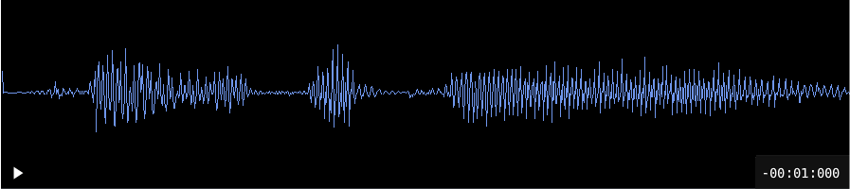


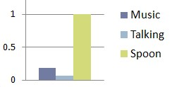
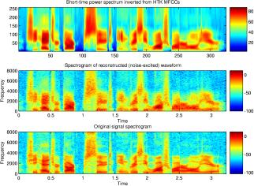
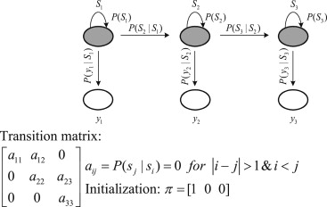
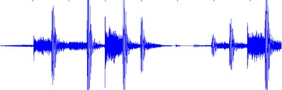
Typical Workflow
annotated DB
context
annotated real life recordings
Talk: 100
Talk:100
Talk: 150
cosine similarity
& k-NN
Music: 150
Spoon: 150
features
Event histogram
HMM/GMM
an unknown audio clip

Slide 7

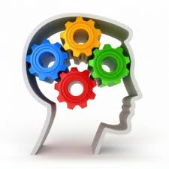
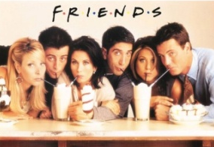
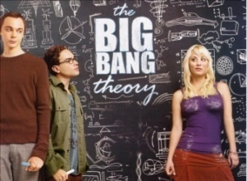




Our work
context
knowledge bases
event vocabulary
air horn
bite apple
hair dryer
piano note
vibrate cell phone
…
…
tv series
transcripts
co-occur
exact similarity
event
audio
clips
sound
search
engines

Slide 8
Roadmap
Introduction
System Implementation
Build An Event Vocabulary
Download Short Audio Clips
Co-Occurrence Collection
Sound Context Inference
Evaluation

Slide 9
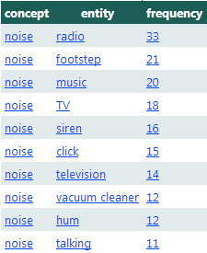
Build An Event Vocabulary
Initialization
sound types listed in FindSounds¹, MediaCollege² and Soundrangers³, instances of sound, noise, sound effect and animal in Probase, hyponyms of sound and noise in WordNet
Lemmatization
WordNet stemmer to stem words.
Discard … noise, … sound effects, …
ambience, sound of ..., etc.
VBG, VBN -> VB
http://www.findsounds.com/types.html
http://www.mediacollege.com/downloads/sound-effects/
http://www.soundrangers.com//index.cfm?category=1&left_cat=1

Slide 10
Build An Event Vocabulary (cont’d)
Formalized Vocabulary
Expansion
iteration
WordNet
Probase
Audible Event Set 1
Audible Event Set 2
merge
Expanded Vocabulary
Sound Search Engine
Verified Vocabulary

Slide 11
Build An Event Vocabulary (cont’d)
Present Vocabulary
alarm system
proportion of covered hyponym
= p = 3/(3+3) = 0.5
…
alarm bell
burglar alarm
Highly Shared Hypernym
…
siren alarm
smoke alarm
Expanded
Event Set
…
car horn
fire alarm
…
shared hyponym count = s = 3

Slide 12
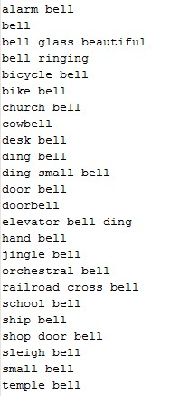
Build An Event Vocabulary (cont’d)
Expansion Threshold
EScore = log10(# of true events) * (# of true events / (# of false events + 1))
s = shared hyponym count, p = proportion of covered hyponyms
Expansion based on WordNet: s = 4, p = 0.4
Expansion based on Probase: s = 32, p = 0.5
Expansion Result
before expansion: 1594 events
after expansion: 4603 events

Slide 13

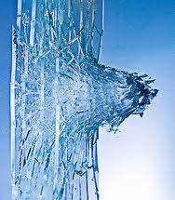


Download Short Audio Clips
Filter Rules
Exact match and synset match.
Duration < 40 seconds.
# of Clips Crawled
145K audio clips for 4603 events
Average: 31 clips per event
aeroplane_18
glass window break_5
spoon_15
waterfall_82

Slide 14
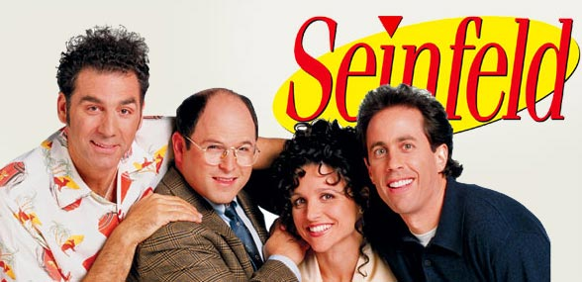
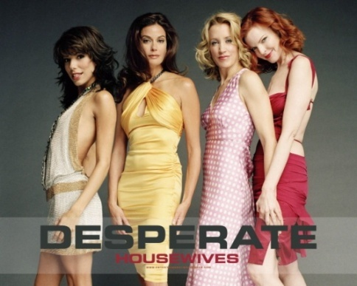

Co-Occurrence Collection
TV Series Scripts
Top 50 series from Most Voted TV Series from IMDb⁴ (Internet Movie Database), 30 transcript archives of which are downloaded.
http://www.imdb.com/search/title?sort=num_votes,desc&title_type=tv_series
Genre | # of Series | # of Episodes
Comedy | 11 | 1233
Crime & Mystery | 9 | 799
Sci-Fi & Action | 7 | 773
Romance | 9 | 826
Animation | 4 | 470
Total (1989-2011) | 30 | 3163

Slide 15
Co-Occurrence Collection (cont’d)
Approach
Context Extraction
Context-Event Co-occurrence
Context | Count
store | 35
bar | 25
kitchen | 17
cafeteria | 81
corridor | 21
office | 38
lab | 19
car | 48
bedroom | 103
conference
photograph 1
people 2
laugh 1
data 1
conversation 1
phone 1
doctor 1
science 3
explode 1
presentation 1
apple 2
paper 1
…

Slide 16
Co-Occurrence Collection (cont’d)
Problems & Solutions
Cannot recognize contexts like Cheesecake Factory, Central Perk.
Named Entity Recognition (NER)
Central Perk -> cafeteria : Probase taxonomy
Words like can and show are ambiguous.
Part-Of-Speech (POS) tagging
Topics and things that really happened are not very distinguishable.
Hopefully, event frequency can solve it.

Slide 17
Co-Occurrence Collection (cont’d)
Result
Rank co-occurred events by score:
SigScore(e) = frequency of e in corpus
* log(# of contexts/# of contexts that e co-occurred with)
* log(# of clips)
Manually selected 10 contexts.
office
desk 2420.1
phone rings 1814.7
phone dial 1814.7
open door 1377.1
chair 1250.5
scan 895.1
pick phone 787.3
pen 749.5
drawer 664.1
hang phone 262.7
conversation 219.6
shredder 200.9
page flip 167.9
click computer mouse 148
printer 132.1
Copier 63.7
computer keyboard 57.5
church
church bell 292.2
toll 144.5
pray 129
cathedral 97.7
silence 67.7
chant 34.2
audience applause 30
piano 24.8
choir 22.1

Slide 18
Sound Context Inference
Feature Extraction
13-dim MFCC, its 1st-order and 2nd-order time derivative
Event Classification
For each event (applause, car horn, copier, toilet flush, etc.) :
a 5-state left-to-right HMM with 16 Gaussian components;
Transition probability from one event model to another :
according to co-occurrence

Slide 19


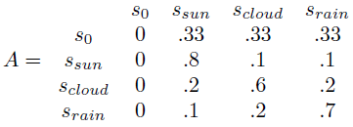
Sound Context Inference (cont’d)
HMM/GMM
Assumptions
Limited Horizon Assumption
Stationary Process Assumption
Markov Model: reason about states over time
Given a set of states S = {s₁, s₂, …s_{|S|}} we can observe a series over time
S.
Parameterize transitions by defining transition matrix A:
A_{ij} = probability of transitting from state i to j at any time t.
e.g. A weather system S = {sun, cloud, rain},
we observe the weather over a few days
{z₁ = sun, z₂ = cloud, z₃ = cloud, z₄ = rain,
z₅ = cloud}.

Slide 20



Sound Context Inference (cont’d)
MM aims to solve 2 problems:
The probability of a particular state sequence given A
Estimate A given an observed sequence
Hidden Markov Model
The states in S can not be observed, but some outputs.
An output alphabet V = {v₁, v₂, …, v_{|V|}},
An emission matrix B where B_{ij} = the probability that output v_{j} is generated by state s_{i}.
e.g. output alphabet is the # of ice creams consumed {1 ice cream, 2 ice creams, 3 ice creams)

Slide 21
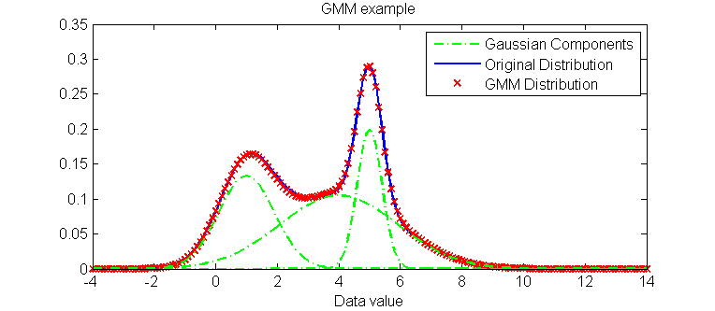
Sound Context Inference (cont’d)
HMM aims to solve 3 problems:
Probability of an observed sequence
Estimate matrix A and B given some observed sequences
Estimate the most likely series of states to generate the observations
Why GMM?
Matrix B for discrete variables
GMM for continuous ones

Slide 22

Sound Context Inference (cont’d)
Guess where they were recorded:)
bar, beach, cafeteria, church, concert, office, park, street, toilet or train?

Slide 23
Roadmap
Introduction
System Implementation
Evaluation
Performance Evaluation
Future Work

Slide 24
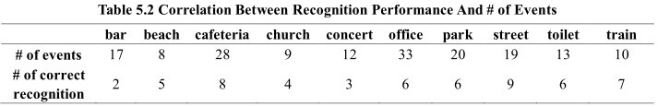
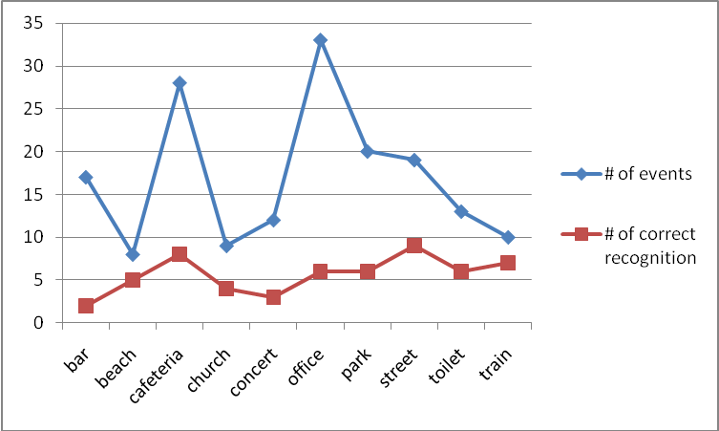
Evaluation
Performance Evaluation

Slide 25
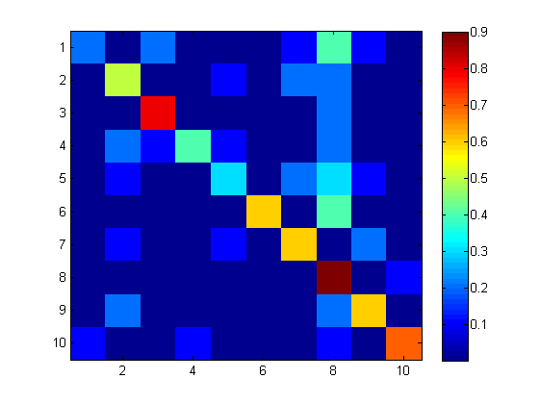
Evaluation (Cont’d)
bar -> cafeteria
bar -> street: drum set -> car start
church -> beach :
chant -> ocean wave
office -> street:
copier -> bus
toilet -> beach : toilet flush -> ocean wave

Slide 26
Evaluation (Cont’d)
Future Work
Enlarge text corpus.
A combination of multiple audio features, especially some temporal features like ZCR.
Customize the number of GMM components for different events.
Try to replace the co-occurrence collection session by some other techniques, such as Google similarity distance.
Thanks for listening :)

